Slide 1
"Exploring Cars24 - Data Analysis Project"
Project Overview:
Leveraging SQL queries to gain insights into the CARS24 dataset and optimize business strategies.
NAME
Siddharth Tiwari

Slide 2
Introduction
Cars24 is an Indian multinational online used cars marketplace headquartered in Gurgaon. It considered one of the major organized players in the used car segment in India.
The Cars24 dataset encompasses details of used cars sold through the platform.
The featuring information such as car model, manufacturing year, selling price, kilometers driven, fuel type, seller type, transmission, owner history, mileage, engine displacement, maximum power, and the number of seats.
This analysis aims to extract meaningful business insights, understand market trends, and enhance decision-making processes.
By utilizing SQL queries, we can efficiently analyze large datasets, uncover patterns, and inform strategic decisions.

Slide 3
Dataset Overview
Cars24 is a leading platform for buying and selling used cars. The company utilizes advanced technology and data analytics to streamline the car selling process, offering convenience and transparency to customers.
The datasets analyzed from cars24 reveled several interesting trends and Insights.
One Significant finding was the positive correlation between vehicle age and price reduction.
Another interesting pattern discovered was the strong relationship between mileage and price.
Key Columns Include-:
Car Model Name
Year
Mileage km_driven
Fuel
Seller Type
Transmission
Owner
Mileage
Engine [CC]
Max Power
Seats

Slide 4
Methodology
We employed SQL queries to extract and analyze relevant data from the Cars24 database.
Our methodology involved data cleaning, filtering outliers, and aggregating information for a comprehensive analysis.
SELECT query : Retrieving specific columns and rows of data from a table.
select * from table name;
WHERE clause : Filtering data based on conditions.
select * from table name where condition (id, name, etc.)
LOGICAL operator : Condition is a combination of one or more expression.
- select * from table name where condition and / or / not condition;
DISTINCT : Remove duplicate rows from the columns.
- select distinct (column name) from table name.

Slide 5
ORDER BY clause : Sorting data in a specific order.
select column name from table name where condition order by column name asc / desc;
JOINs : Combining data from multiple tables.
select table name A. column
name from table
name A left / right / inner / cross join table
name B on table
name A = table
name B order by column
name;
AGGREGATION function (SUM, AVG, COUNT, etc.) : Calculating summary statistics.
select sum / avg / count (column name) from table name;
DELETE : Used to delete existing record in a table.
Delete from table name where condition;
GROUP BY clause : Grouping data and performing calculations on groups.
select column name from table name where condition group by column name;
SUB-QUERIES : Using one query within another for complex filtering or calculations.
select column name from table name where condition A in ( select condition A from table where condition B;

Slide 6
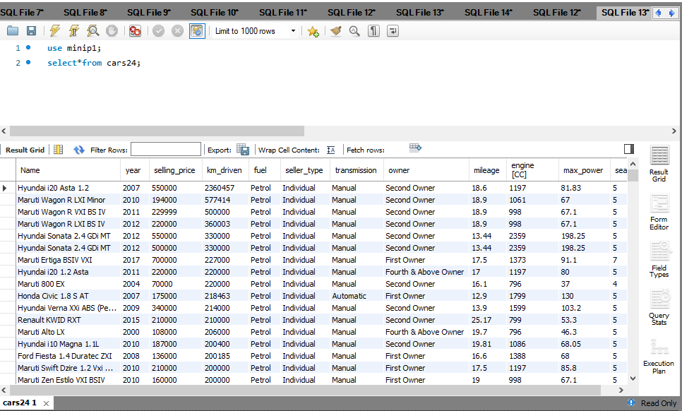
Insight 1: Reading the whole table

Slide 7
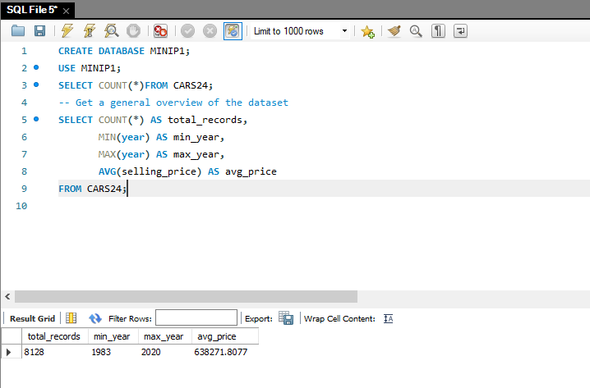
Insight 2: Overview of the Dataset

Slide 8
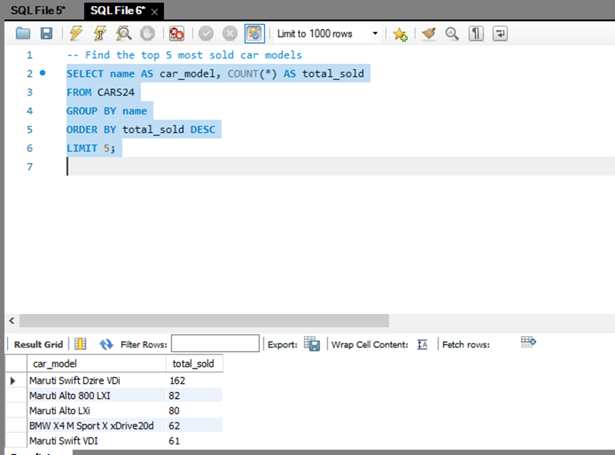
Insight 3: Top 5 Most Sold Car Models

Slide 9
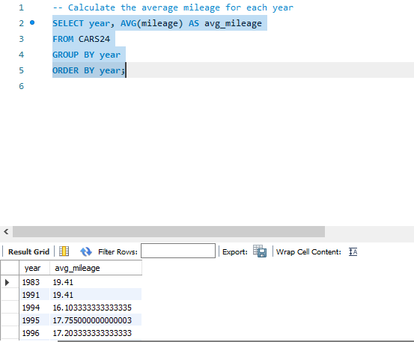
Insight 4: Average Mileage by Year

Slide 10
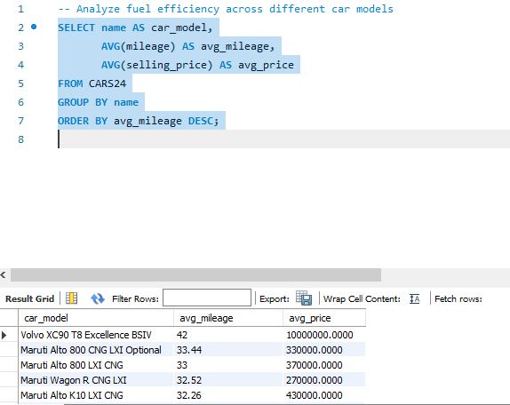
Insight 5: Fuel Efficiency Analysis

Slide 11
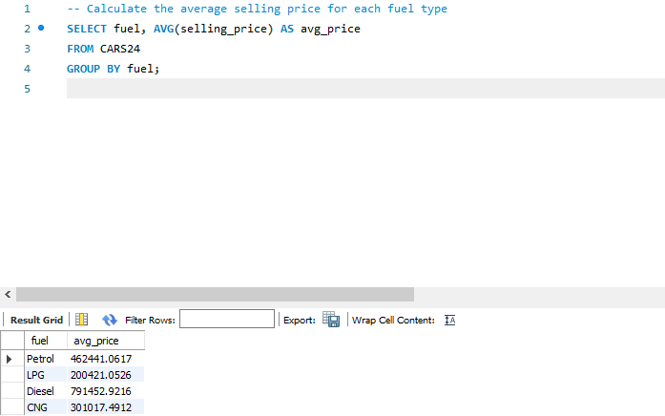
Insight 6: Average Selling Price by Fuel Type

Slide 12
Conclusion
CARS24 is the best platform to buy or sell used cars because it provides detailed information about aspects such as mileage, engine capacity (cc), the age of the car model, fuel types, and transmission.
Cars24 has two types of seller.
Individuals : These are private individuals who buy or sell cars for personal use. They may be individuals acting alone or with their family.
Dealer : Dealers are businessperson who buy or sell cars to meet the needs of others. They operate in specific market or regions and advice to customers based on their requirements.
Cars24 has the most individuals seller and they all sell their cars in good conditions.

Slide 13
Future Work
As Cars24 continues to expand its market presence and technological capabilities, the company is poised to further transform the automotive industry. The future holds immense potential for growth and innovation.
Regularly update and retrain models with new data to ensure they stay relevant and accurate over time.
Monitor model performance and make adjustments as needed.

